Slide 1
Design and Analysis of Algorithms

Slide 2
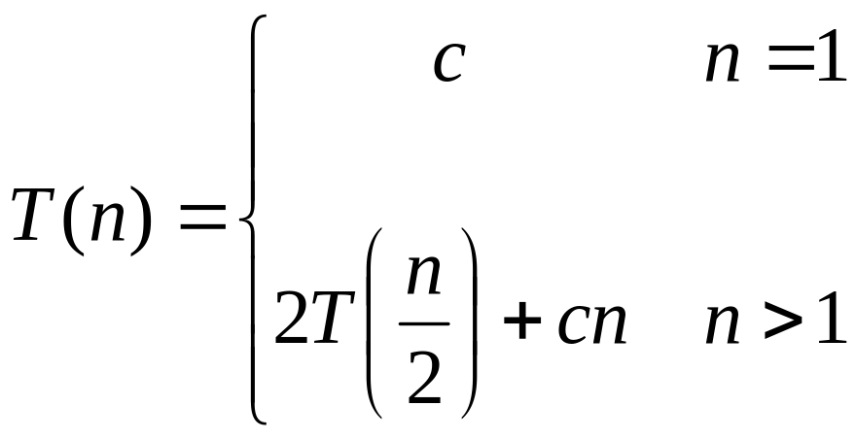
Recurrences
The expression:
is a recurrence.
  Recurrence: an equation that describes a function in terms of its value on smaller functions

Slide 3

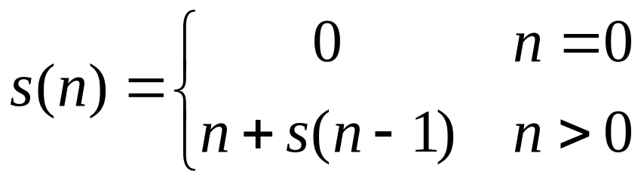
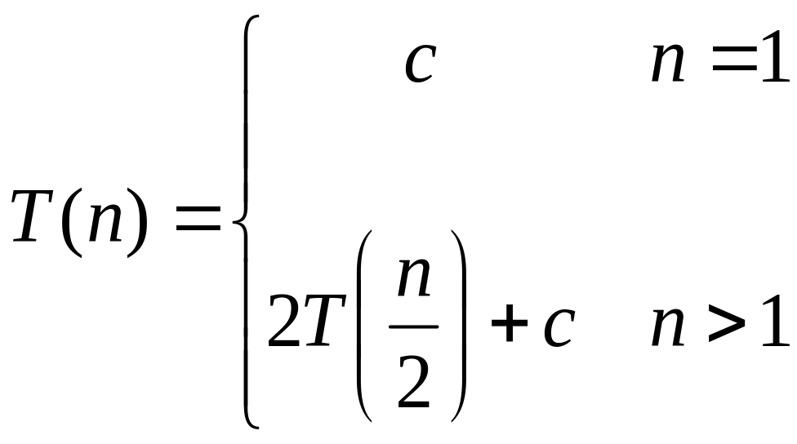

Recurrence Examples

Slide 4
Methods to solve recurrence
Substitution method
Iteration method
Recursion tree method
Master Theorem

Slide 5
Solving Recurrences
The substitution method
  A.k.a. “making a good guess method”
  Guess the form of the answer, then use mathematical induction to find the constants and show that the solution works
  Example:
    T(n) = 2T(n/2) + n → T(n) = O(n lg n)

Slide 6
Solving Recurrences
Another option is “iteration method”
  Expand the recurrence
  Work some algebra to express as a summation
  Evaluate the summation
We will show several examples

Slide 7

s(n) =
c + s(n-1)
c + c + s(n-2)
2c + s(n-2)
2c + c + s(n-3)
3c + s(n-3)
…
kc + s(n-k) = ck + s(n-k)

Slide 8
So far for n >= k we have
  s(n) = ck + s(n-k)
What if k = n?
  s(n) = cn + s(0) = cn

Slide 9
So far for n >= k we have
  s(n) = ck + s(n-k)
What if k = n?
  s(n) = cn + s(0) = cn
So
Thus in general
  s(n) = cn

Slide 10
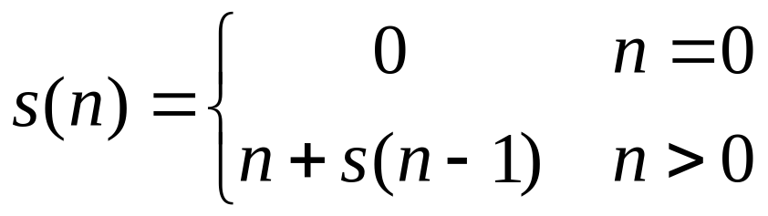
s(n)
= n + s(n-1)
= n + n-1 + s(n-2)
= n + n-1 + n-2 + s(n-3)
= n + n-1 + n-2 + n-3 + s(n-4)
= …
= n + n-1 + n-2 + n-3 + … + n-(k-1) + s(n-k)

Slide 11
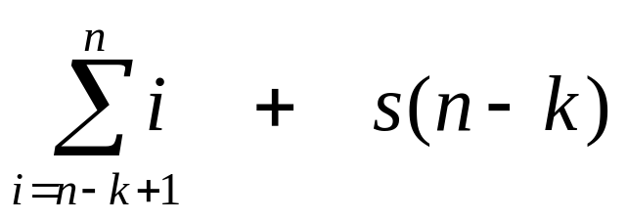
s(n)
= n + s(n-1)
= n + n-1 + s(n-2)
= n + n-1 + n-2 + s(n-3)
= n + n-1 + n-2 + n-3 + s(n-4)
= …
= n + n-1 + n-2 + n-3 + … + n-(k-1) + s(n-k)
=

Slide 12
So far for n >= k we have

Slide 13
So far for n >= k we have
What if k = n?

Slide 14
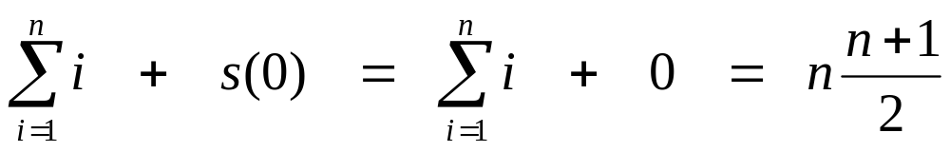
So far for n >= k we have
What if k = n?

Slide 15
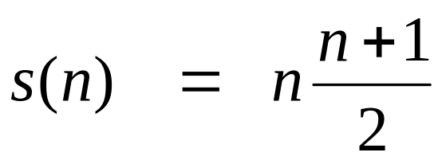
So far for n >= k we have
What if k = n?
Thus in general

Slide 16
Divide and Conquer
The divide-and-conquer paradigm
What is a paradigm? One that serves as a pattern or model.
Divide the problem into a number of subproblems
Conquer the subproblems by solving them recursively. If small enough, just solve directly without recursion
Combine the solutions of the subproblems into the solution for the original problem

Slide 17
Analyzing Divide-and-Conquer Algorithms
Let T(n) be the running time on a problem of size n.
If problem is small enough, then solution takes constant time (this is a boundary condition, which will be assumed for all analyses)
It takes time to divide the problem into sub-problems at the beginning. Denote this work by D(n).

Slide 18
Analyzing Divide-and-Conquer Algorithms
It takes time to combine the solutions at the end. Denote this by C(n).
If we divide the problem into ‘a’ problems, each of which is ‘1/b’ times the original size (n), and since the time to solve a problem with input size ‘n/b’ is T(n/b), and this is done ‘a’ times, the total time is:
T(n) = Θ(1), n small (or n ≤ c )
T(n) = aT(n/b) + D(n) + C(n)

Slide 19
Example
Function(int number)
  if number<=1
  then return;
  else
  Function(number/2)
  Function(number/2)
  for(i=1 to number )
        Display i;
It follows that
T(n) = 2 T(n/2)+ cn
work done dividing and combining
number of sub-problems
Sub-problem size

Slide 20
Recursion Tree for Algorithm
cn
T(n/2)
T(n/2)

Slide 21
Recursion Tree for Algorithm
cn
cn/2
cn/2
T(n/4)
T(n/4)
T(n/4)
T(n/4)

Slide 22
Recursion Tree for Algorithm
cn
cn/2
cn/2
T(n/4)
T(n/4)
T(n/4)
T(n/4)
Eventually, the input size (the argument of T) goes to 1, so...

Slide 23
Recursion Tree for Algorithm
cn
cn/2
cn/2
T(n/4)
T(n/4)
T(n/4)
T(n/4)
T(1)
T(1)
T(1)
T(1)
.............................
T(1)
T(1)
n sub problems of size 1, but T(1) = c by boundary condition

Slide 24
Recursion Tree for Algorithm
cn
cn/2
cn/2
T(n/4)
T(n/4)
T(n/4)
T(n/4)
c
c
c
c
.............................
c
c
n subproblems of size 1

Slide 25
Recursion Tree for Algorithm
level nodes/ cost/
level level
0 2⁰ = 1 cn
1 2¹ = 2 cn
2 2² = 4 cn
. .
. .
. .
N-1 2^{N-1}=n cn
Since 2^{N-1} = n,
N-1 = lg(n)
levels = N = 1+lg(n)
T(n) = total cost = (levels)(cost/level)
T(n) = cn [1+lg(n)] = O( n lg(n))
n nodes at level N-1

Slide 26
The Master Theorem
Given: a divide and conquer algorithm
  An algorithm that divides the problem of size n into “a” subproblems, each of size “n/b”
  Let the cost of each stage (i.e., the work to divide the problem + combine solved subproblems) be described by the function f(n)
Then, the Master Theorem gives us a cookbook for the algorithm’s running time:

Slide 27
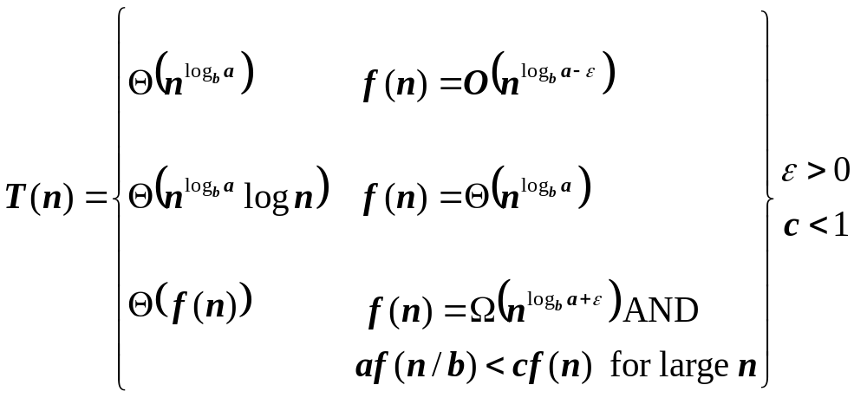
The Master Theorem
if T(n) = aT(n/b) + f(n) then

Slide 28
Using The Master Method
T(n) = 9T(n/3) + n
  a=9, b=3, f(n) = n
  n^{logb a} = n^{log3 9} = Θ(n²)
  Since f(n) = O(n^{log3 9 - ε}), where ε=1, case 1 applies:
  Thus the solution is T(n) = Θ(n²)

